Slide 1
DDPG CAD: Intelligent Channel Activity Detection Scheduling in Massive IoT LoRaWAN
Mhatre, Jui & Lee, Ahyoung & Lee, Hoseon & Nguyen, Tu. (2024). DDPG_CAD: Intelligent Channel Activity Detection Scheduling in Massive IoT LoRaWAN. 248-252. 10.1109/NetSoft60951.2024.10588888.

Slide 2
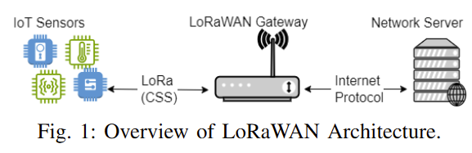
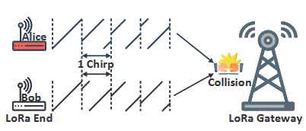
Paper Summary
IoT LoRa Overview
Common Problems with LoRa - Collisions
One Proposed Solution – Channel Activation Detection (CAD)
Before an end device sends its data, it senses what channels on the gateway are busy and won't send the packet if there are all busy.

Slide 3
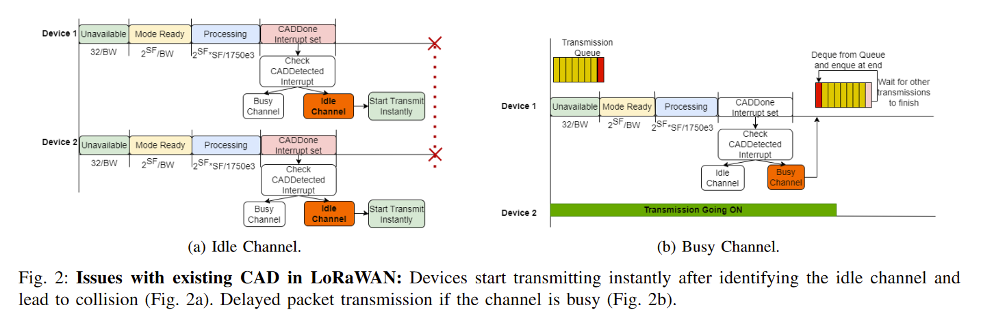
Paper Summary
CAD has a few edge cases that cause it to fail
The writers realized if we add a small extra random delay, we can fix overlap problems.

Slide 4
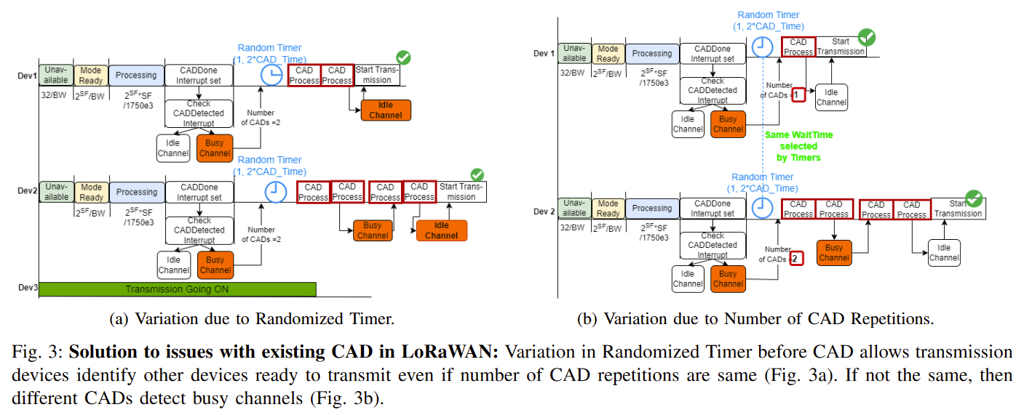
Paper Summary
They use a Deep Deterministic Policy Gradient (DDPG) Reinforcement Learning algorithm to determine what this timer should be.
Some labels include total delay time and energy consumption. Features include the characteristics of the LoRaWAN system.

Slide 5
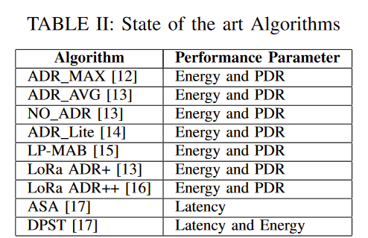
Paper Summary
Experimental Design
In terms of LoRa, energy and packet delivery ratio (PDR) are the most important metrics.
Scalability and density are also important features that also affect how good an algorithm can be.
The writers ran a 2-stage experiment
Firstly, they ran their DDPG algorithm in a simulated environment, to see if their scheduling algorithm has a discernible difference when compared to the baseline.
Secondly, they ran their DDPG algorithm in two specific environments, an urban one and a rural one, to see how device density influences the system.

Slide 6
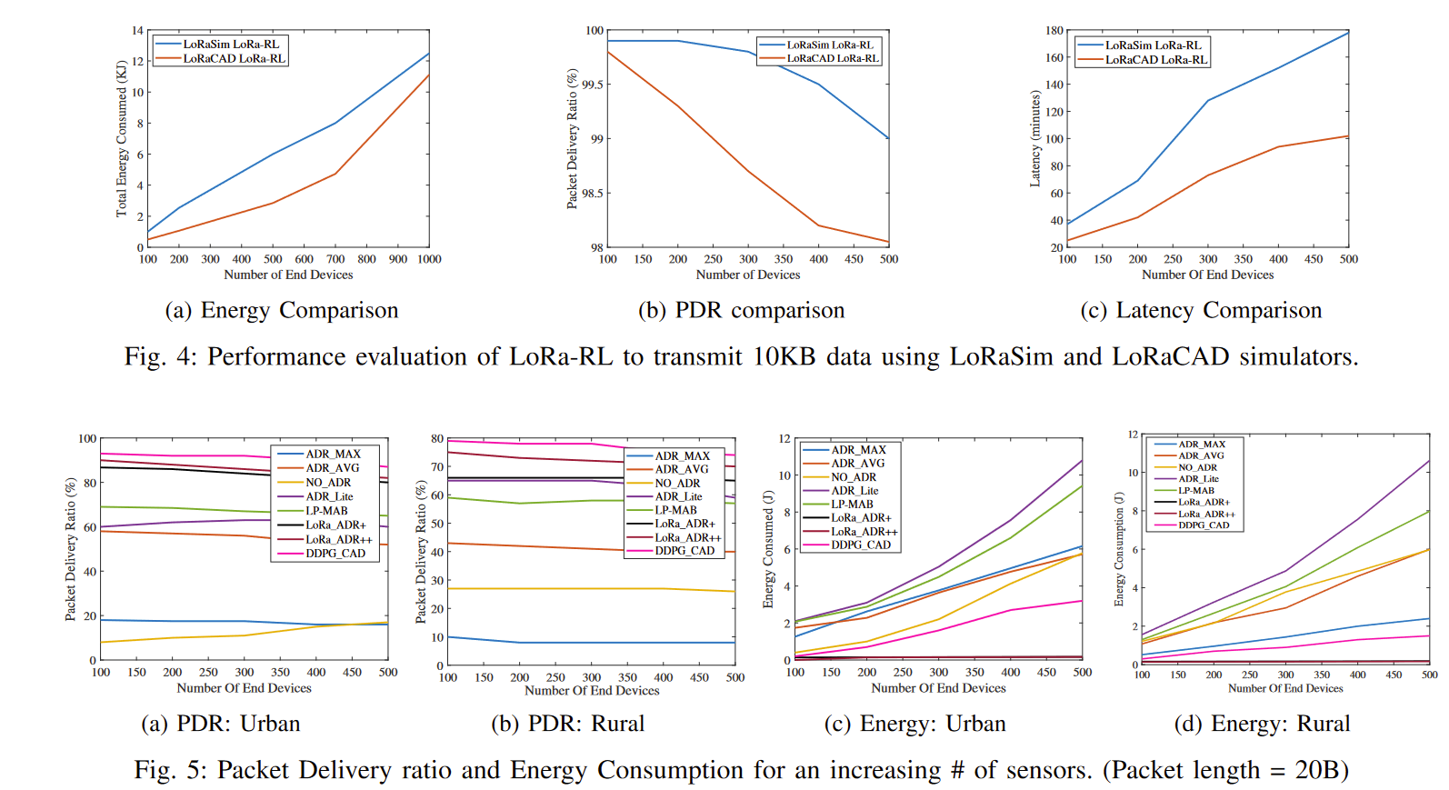
Paper Summary

Slide 7
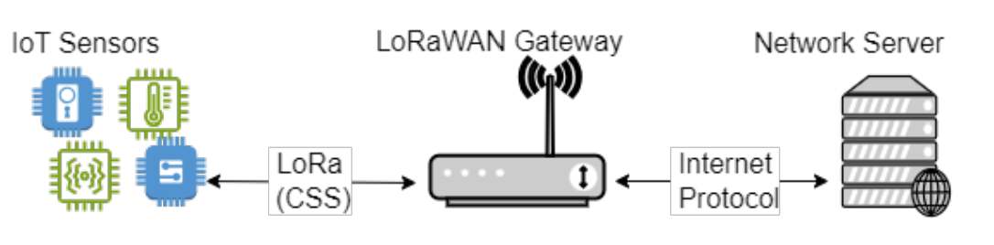
Paper Strengths
Novel Algorithmic Approach
Deep Deterministic Policy Gradient (DDPG) algorithm for Channel Activity Detection (CAD) in LoRaWAN networks leverages reinforcement learning to enhance the efficiency and effectiveness of CAD, which can significantly reduce energy consumption and improve network performance.
Figure 6: The DDPG algorithm provides a new
perspective on tackling CAD challenges

Slide 8
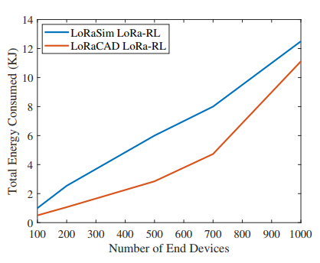
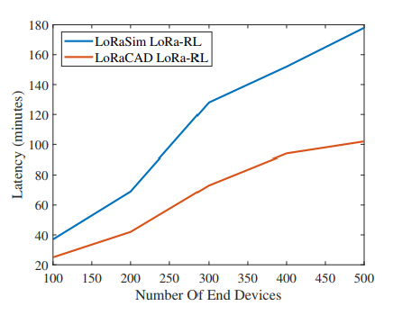
Paper Strengths
Comprehensive Performance Evaluation
The paper provides a detailed performance evaluation of the proposed DDPG-CAD algorithm against traditional energy consumption, packet delivery ratio, and latency methods. Despite its limitations, the use of the LoRaCAD simulator allows for controlled comparisons that highlight the advantages of the proposed solution.
Figure 7: LoRaCAD provides less energy, and less latency than
traditional methods

Slide 9
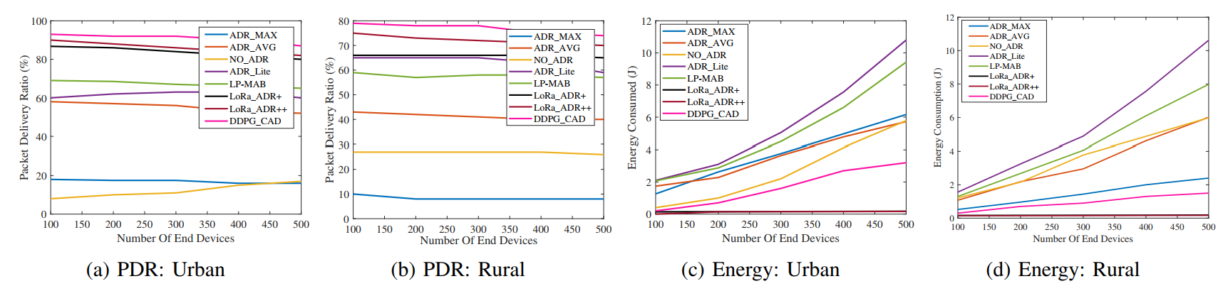
Paper Strengths
Real-World Applicability and Simulation
The LoRaCAD simulator is specifically designed to test and validate CAD strategies in a controlled environment that closely mimics real-world conditions. The inclusion of realistic constraints and parameters in the simulations provides a robust validation of the proposed DDPG CAD approach.
Figure 8: Real-world analysis shows better PDR and less energy consumption of DDPG_CAD

Slide 10
Paper Strengths
Writing and Organizational Clarity
The paper follows a clear and logical structure, making it easy to understand the progression of ideas.
Well-defined sections and subsections help guide the reader through the paper.
The abstract effectively summarizes the main objectives, methods, and findings briefly and clearly.
Figures are well-integrated into the text, providing visual clarity and supporting the data and arguments presented.
The writing is clear and precise, with technical terms well-defined and minimal use of jargon.

Slide 11
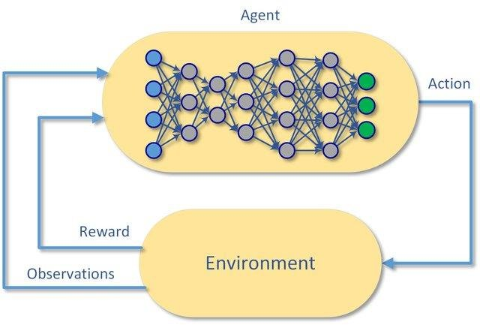
Paper Weaknesses
Lack of Technical Details
The paper does not thoroughly explore the sensitivity of the DDPG algorithm to various parameters such as reward functions and learning rates.
Lack of technical details of DDPG algorithm
Lack of technical details of deep RL model, architecture, and hyperparameters.
Deep Reinforcement Learning

Slide 12
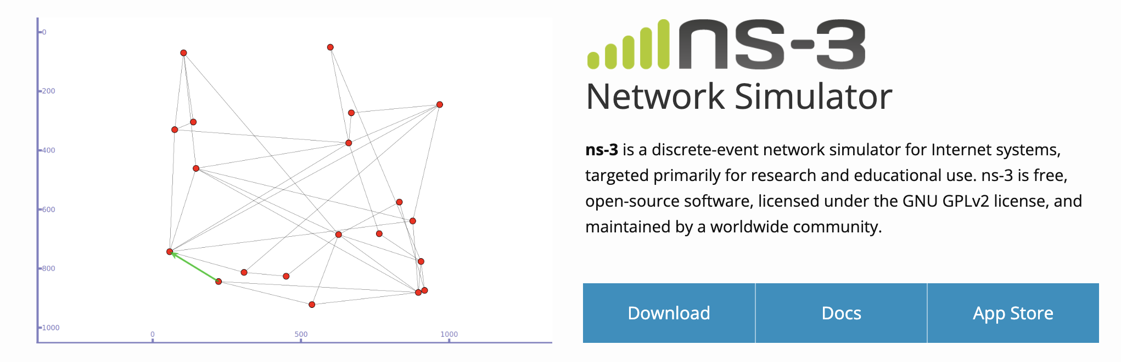
Paper Weakness
Real-world deployment and validation of simulator
The evaluation is primarily based on simulations. Real-world deployment and testing would strengthen the findings.
The robustness and reliability of LoRaCAD simulator needs to be validated with real-world results.
Open-source for better transparency and validation

Slide 13
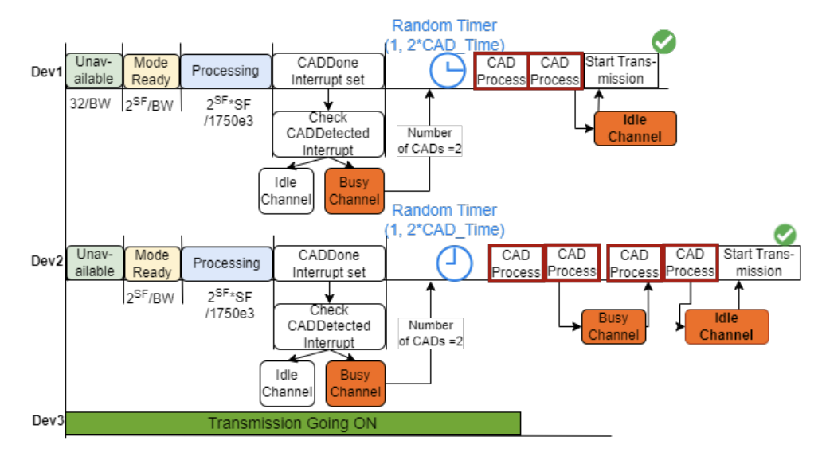
Paper Weakness
Limited Evaluation Scope
Limited evaluation of varying network densities and node distributions.
Simulations assume uniform node distribution and fixed density.
Scalability of the proposed algorithm in real-life large network
How does this algorithm perform, in case of a large number of devices? Is this scalable?

Slide 14
Conclusion and Future Direction
The DDPG CAD algorithm substantially improves energy efficiency and collision avoidance for LoRaWAN networks.
Solving existing data collision and device starvation issues by improving the CAD algorithm
Introduction of LoRaCAD simulator for simulating network environment
Future Expansion
Real-world deployment and testing.
Exploring other ML-based techniques and hybrid approaches.
Applying the algorithm to different LPWAN technologies.

